Slide 1


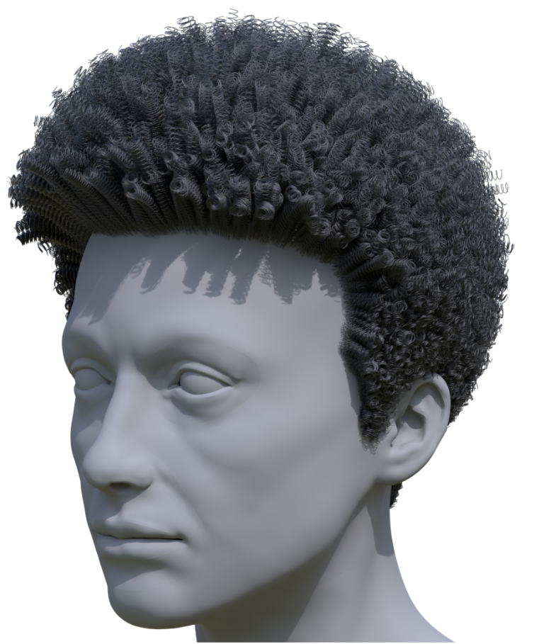
Transforming Unstructured Hair Strands into Procedural Hair Grooms
Wesley Chang¹, Andrew L. Russell¹, Stephane Grabli², Matt Jen-Yuan Chiang², Christophe Hery², Doug Roble², Ravi Ramamoorthi¹, Tzu-Mao Li¹, and Olivier Maury²
¹ University of California San Diego
² Meta Reality Labs
Notes:
Hi I’m Wesley and I’ll be talking about turning hair strands into a representation that is very easy to edit. This is in collaboration with UCSD and Meta.

Slide 2
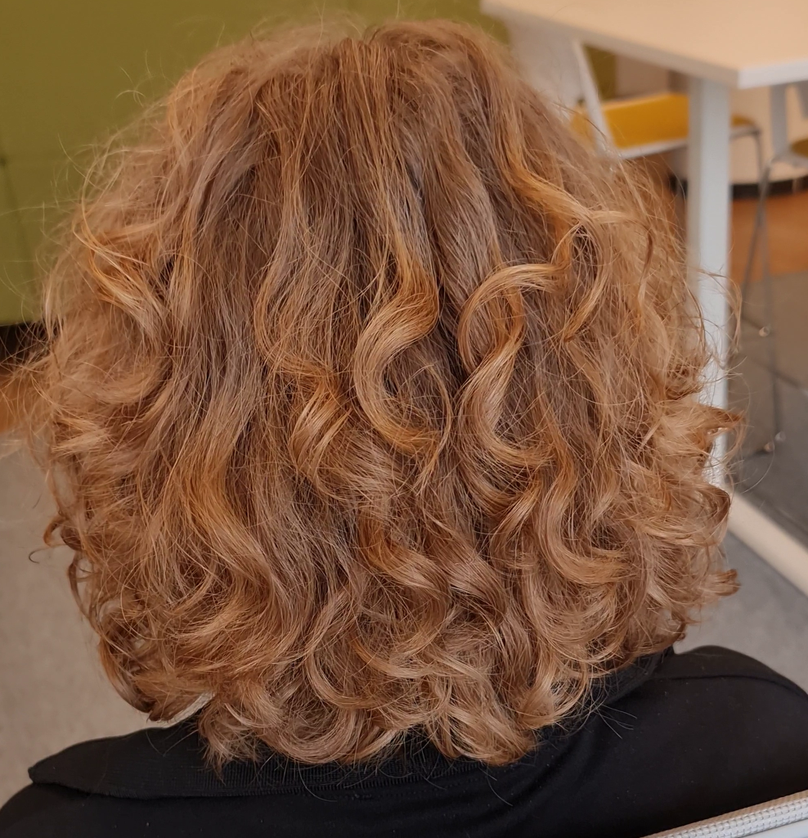
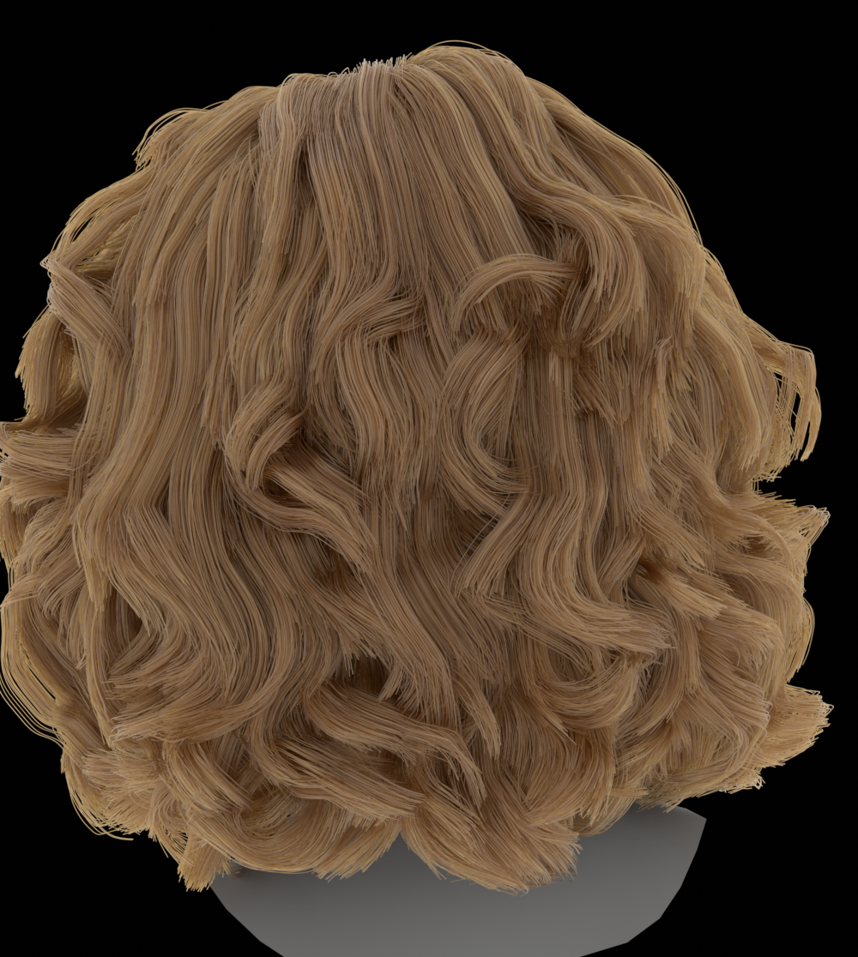
Hair Reconstruction
Video
3D Hair Strands
Notes:
If I had beautiful curly hair like this, the first thing I’d probably do is take a photo of myself. Or maybe a video.
Thanks to great work in the community, we can now reconstruct this into pretty goo 3D hair strands.
But at the moment, the only thing you can often really do with these is just admire them.
What if I wanted a virtual haircut? Or to see this hair flying in the wind?

Slide 3
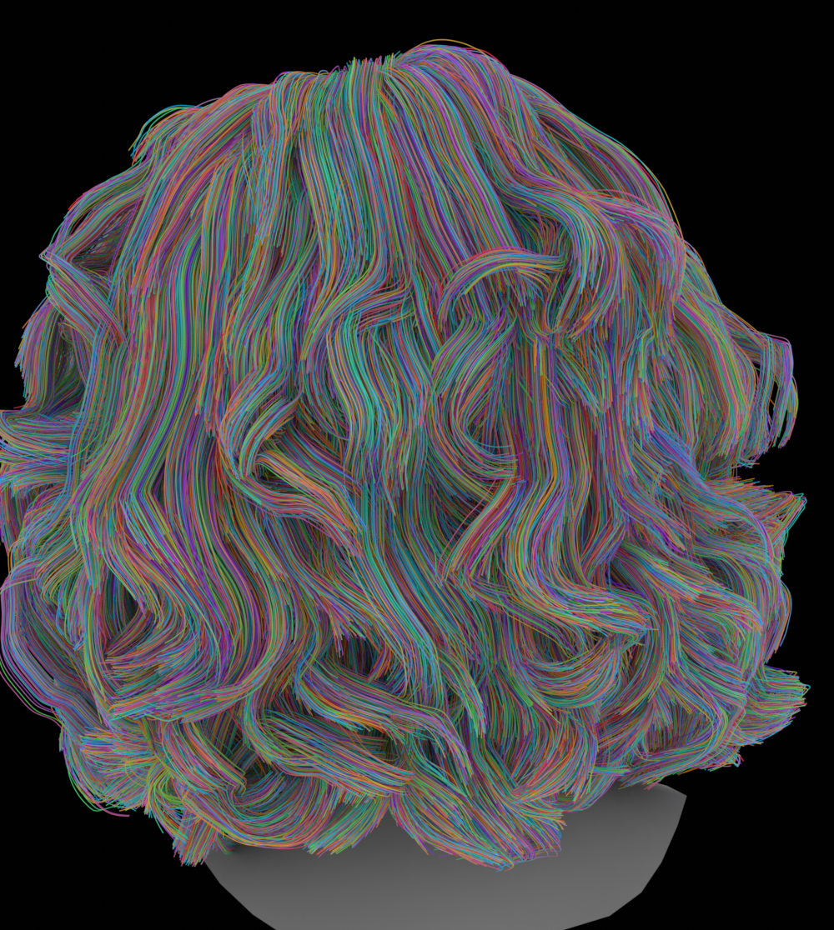
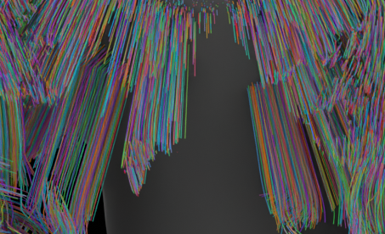
Hair Reconstruction
100k unstructured strands
Difficult to edit!
Poor inner hair structure
Difficult to simulate!
3D Hair Strands
Notes:
The problem is that humans can have around 100k strands and so trying to edit them manually is a nightmare.
In addition, much of the hair is not visible from the outside, and so current reconstruction methods have little guarantees on the inner structure of complex hair.
Without proper hair structure, hair strands cannot be nicely simulated.

Slide 4
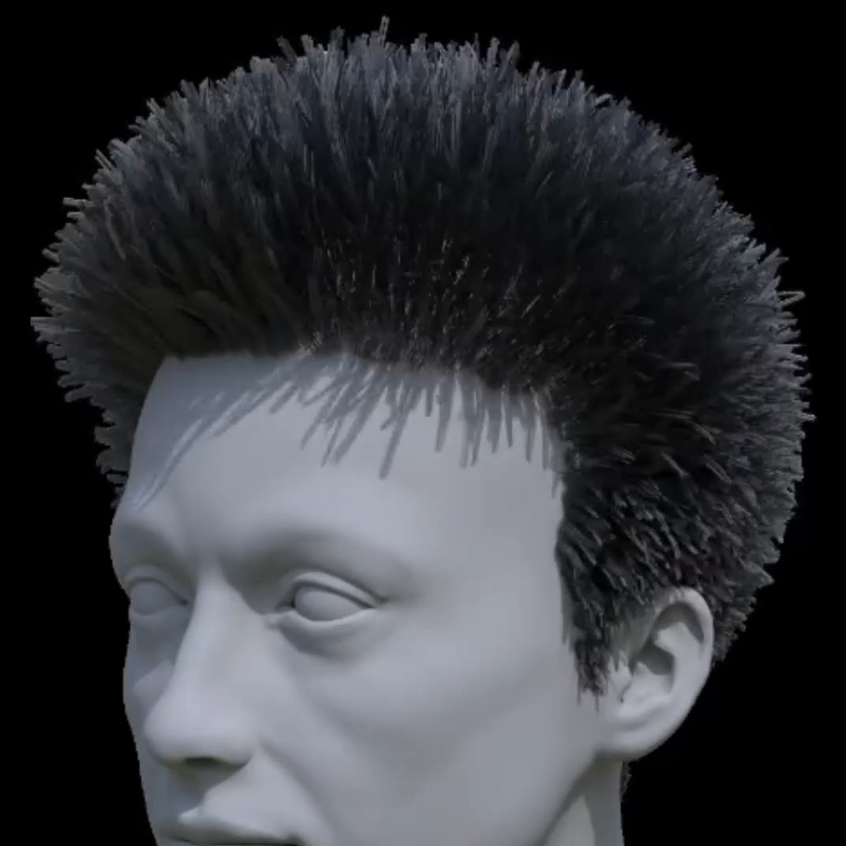
Procedural Editing
Notes:
Editing and simulation is however a frequent task for artist-designed hair grooms used in film. So how do they achieve this? The answer is that artist grooms are typically designed procedurally.

Slide 5
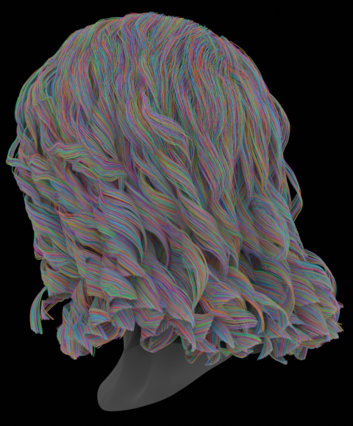
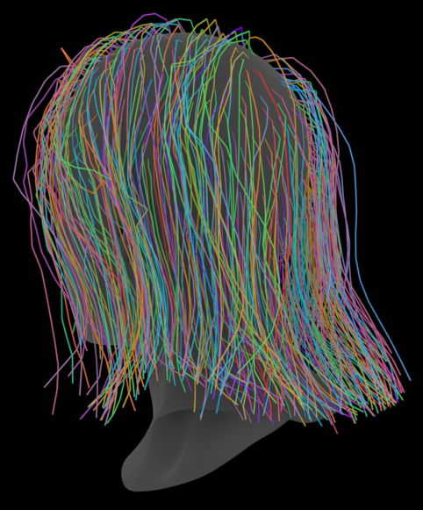
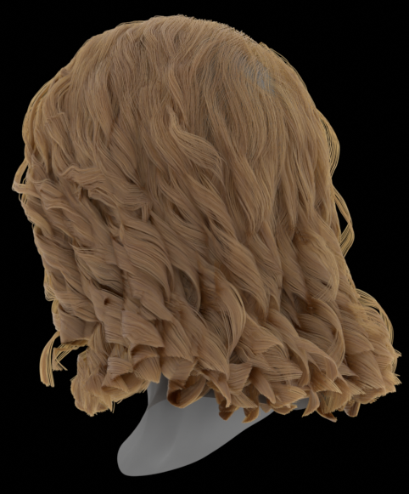

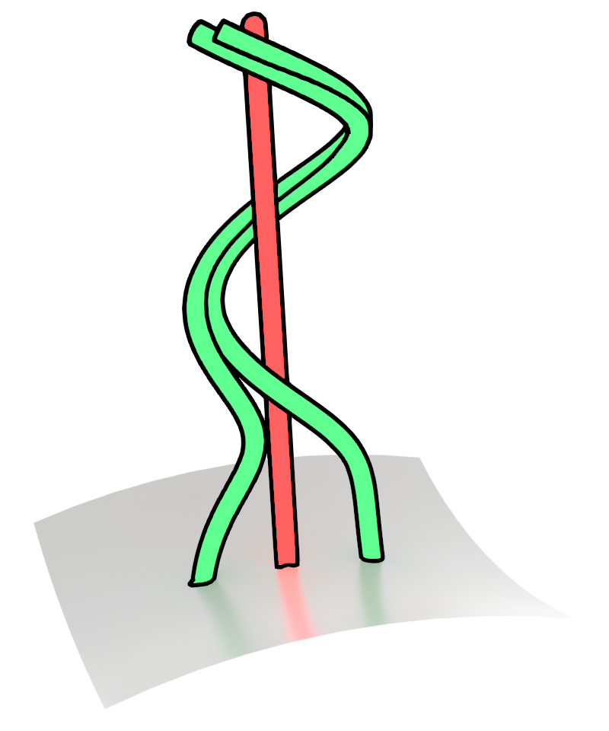
Artist-designed Procedural Grooms
Hard to Edit
Easy to Edit, Guaranteed Structure
100k
1k
Unstructured Strands
Procedural Operators
Procedural Groom
Guide Strands
Notes:
Instead of designing 100k strands one by one, artists will design maybe 1k “guide strands”, which guides where the full dense strands should be, and then style the hair by adding procedural operators, such as curl, which has parameters like radius and frequency, in order to generate the hair.
Not only is this a lot more manageable to edit, even inner hair strands are forced to take the structure from these procedural operators, like the curls.

Slide 6
Our Paper: Unstructured Strands to Procedural Grooms
Input
Outputs
No training data needed!
Optimization
Unstructured Strands
Procedural Groom
Notes:
Our work therefore bridges these two representations: we convert unstructured hair strands into procedural grooms so that can be easily edited and have some structural guarantees to enable applications such as simulation. And we do this using interpretable optimization techniques, no training data required!

Slide 7
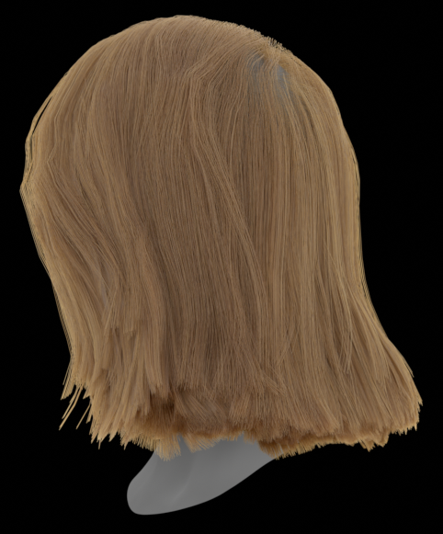
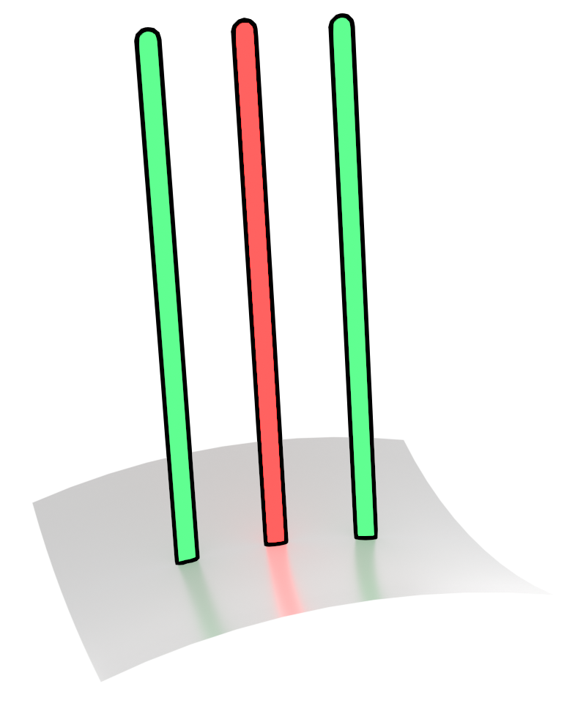
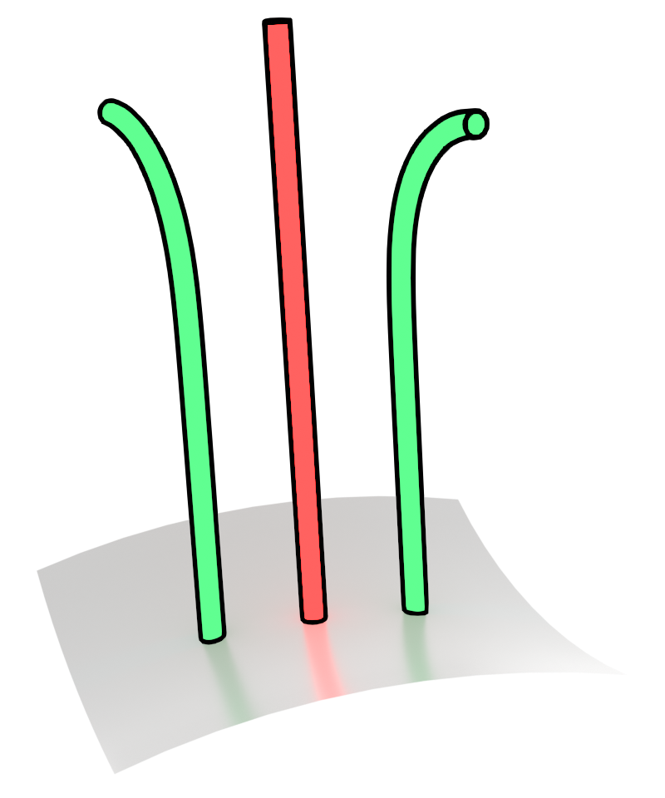
Our Procedural Grooming Pipeline
Instanced Strands
Procedural Operators
Procedural Groom
Guide Strands
Instancing
Notes:
Let’s first discuss how our procedural grooms work. We start with a small set of guide strands that describe the overall shape of the groom. These are interpolated to dense strands using an instancing operation, and then procedurally deformed using operators like curl or bend to obtain the final procedural groom.

Slide 8
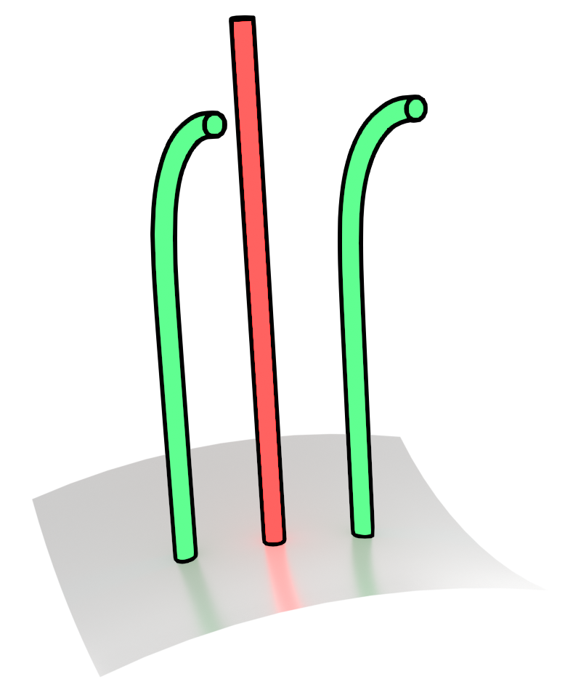


Operators Apply Random Variations to Different Strands
Guide Strand
Instanced Strand
Bend:
θ degrees around axis v
With Random Axis Variation
Without Random Axis Variation
Notes:
In order to make this look realistic, strands should have some variation, and so these operators deform different strands in random amounts.
So for example, our bend operator bends a strand an angle around an axis. With random variation, it bends different strands the same angle around different axes.
Here, the guide strand is in red, while the instanced strands are in green.

Slide 9
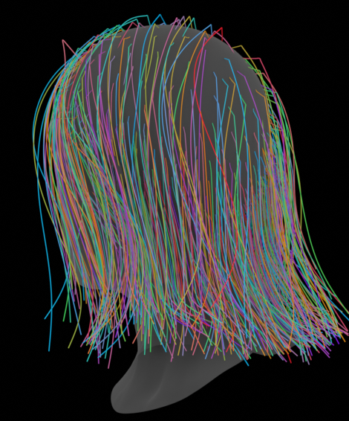

Optimization Task
Procedural Groom
Grooming Pipeline
Guide Strands
Loss Function
Procedural Operators
Unstructured Strands
Backpropagation
?
1.7
Curl Radius:
1.5
Outputs
Input
Notes:
In our work, our optimization task is to take target 3D hair strands with some fixed set of operators and find the guides and parameters to best match the target. Since there is a considerable number of parameters, the obvious way to attempt to solve this is to use gradient based optimization. Take an initial guess of the guides and parameters, run the procedural pipeline to get a groom, see how close we are to the target strands using a loss function, backpropagate to get gradients which are used to improve the parameters, and iterate this in order to decrease the loss.

Slide 10
Loss Function
Procedural Groom
“Distance” between unstructured strands and procedural groom?
Unstructured Strands
Notes:
So what is hard about this? It’s not obvious what this loss function should be. Loss functions should measure a distance between strands, but this is not easy.

Slide 11
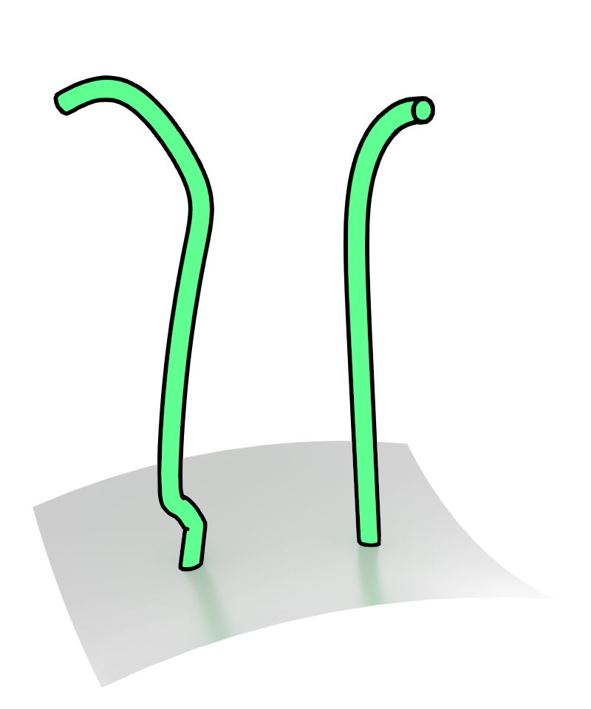
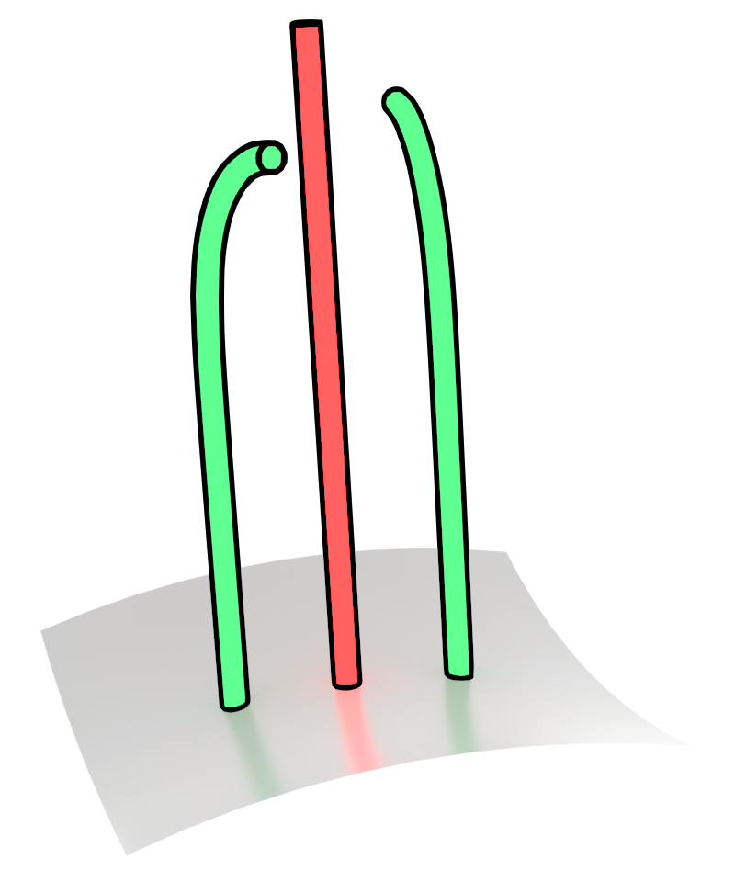
Distance is Hard
Correct parameters ≠ Same strands!
Cannot be represented
using 1 guide + bend
Same bend angle,
Different random axis
Notes:
This is because we cannot expect our procedural groom to match the target strands exactly. The reason is that procedural grooms cannot represent every set of strands since they do not have explicit control over every strand. For example, no single guide and bend can produce one noisy strand and one smooth strand.
Even if the target strands themselves were procedural, an exact match is unlikely to happen, since operators deform strands with randomness. This means that we can have differing strands even with correct parameters. Here the bend angle is correct, but the strands are bent around different random axes.

Slide 12
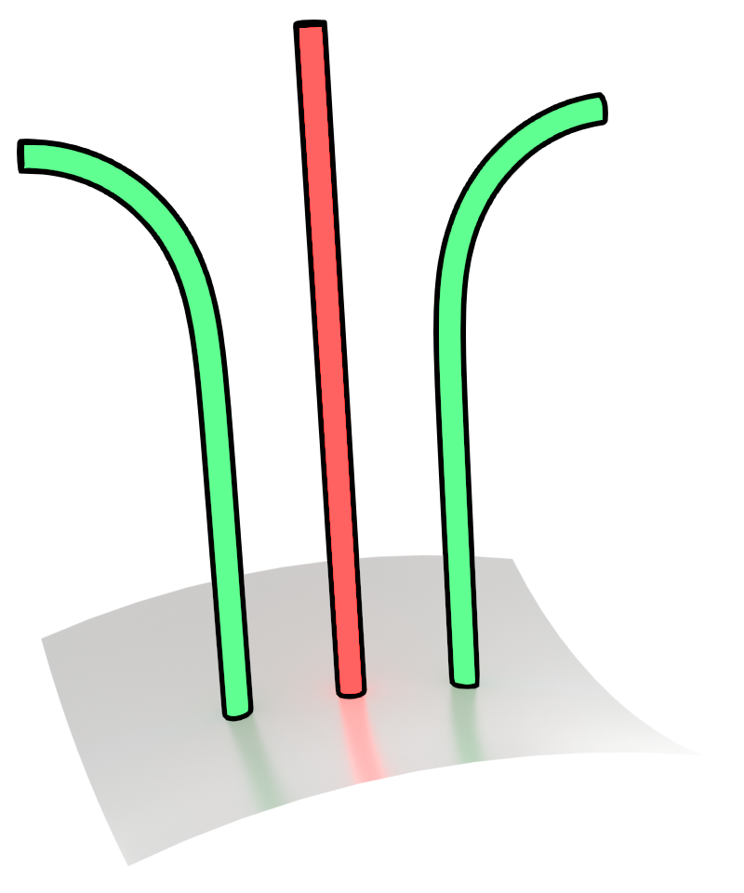
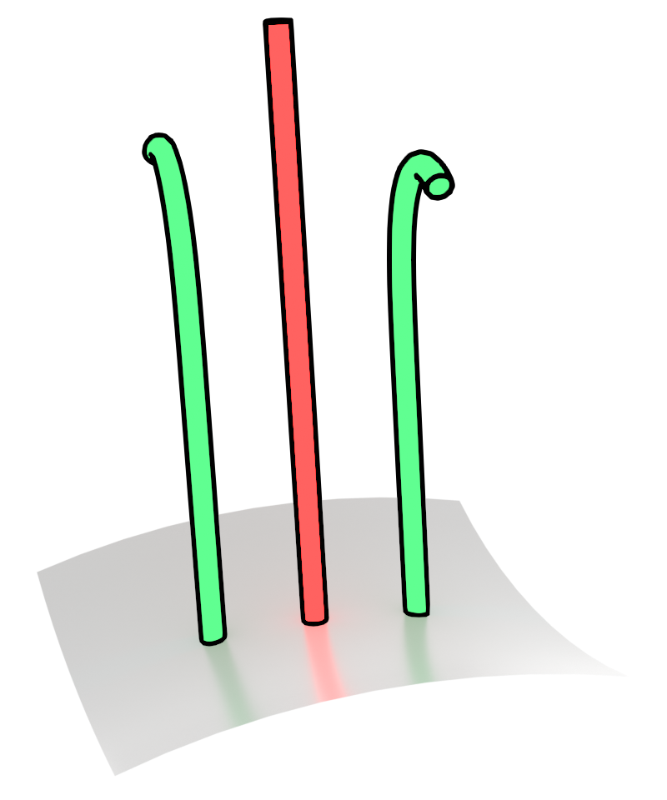
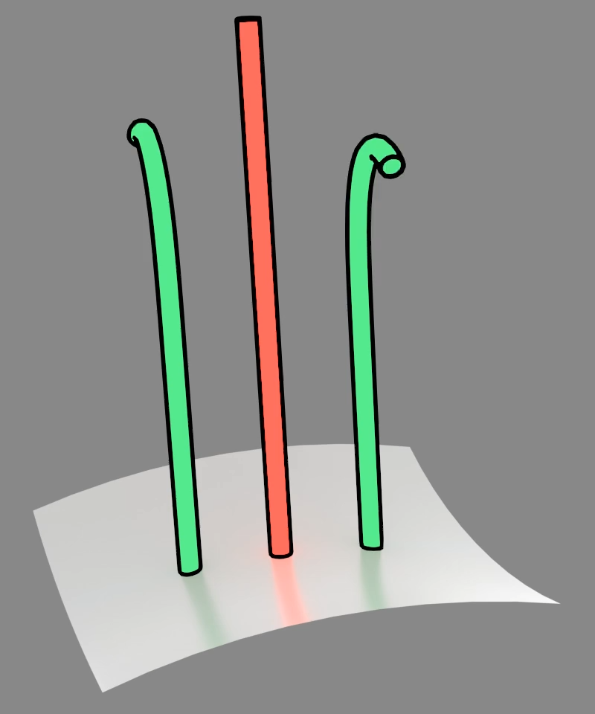
Naïve Distance Gives Incorrect Parameters
Distance between corresponding points on strands
Target Strands
Optimized
Initial
Notes:
Lets see what happens if we try to find the bend angle that matches these target strands using a simple naïve loss function that measures the distance between corresponding points on the strands. Notice that the bend axes are perpendicular to each other. Because of this, if I run an animation of an optimization using this distance, the configuration that gives the smallest distance between strands is to not bend the strands at all, which is clearly incorrect, as the target strands are bent.

Slide 13
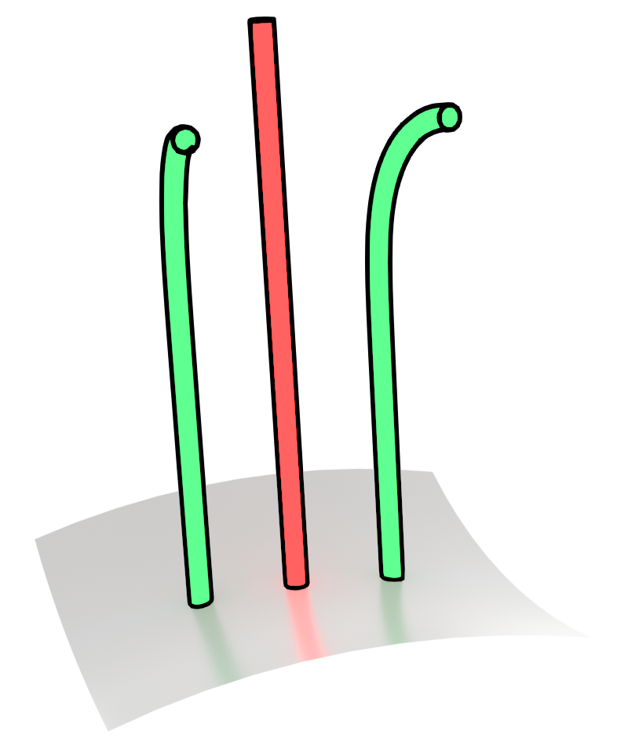
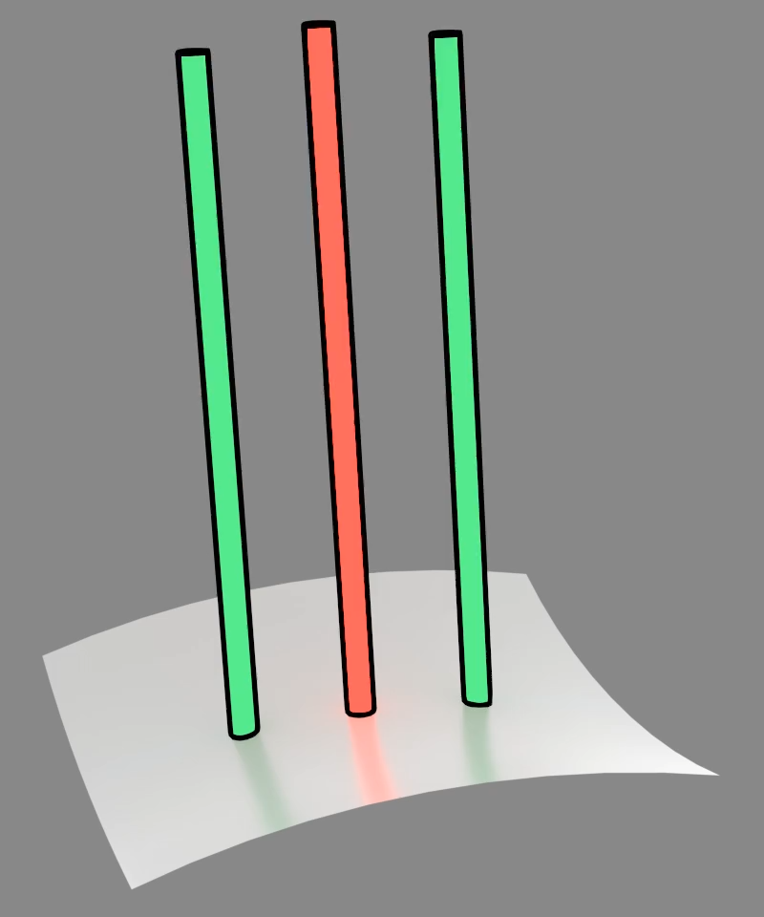


Guide and Operator Ambiguity
Bend in Operator
Bend in Guides
Target Strands
Optimized
Initial
Notes:
Furthermore, there is ambiguity between guide strands and operators - for bent strands, do we have a bent guide strand or a bend operator?
For editibility reasons, we want deformations that can be applied using operators to be applied by the operators, but if we naively try to optimize the procedural groom by using the same distance in the previous slide, due to the ambiguity, we’ll often get bent guides.

Slide 14
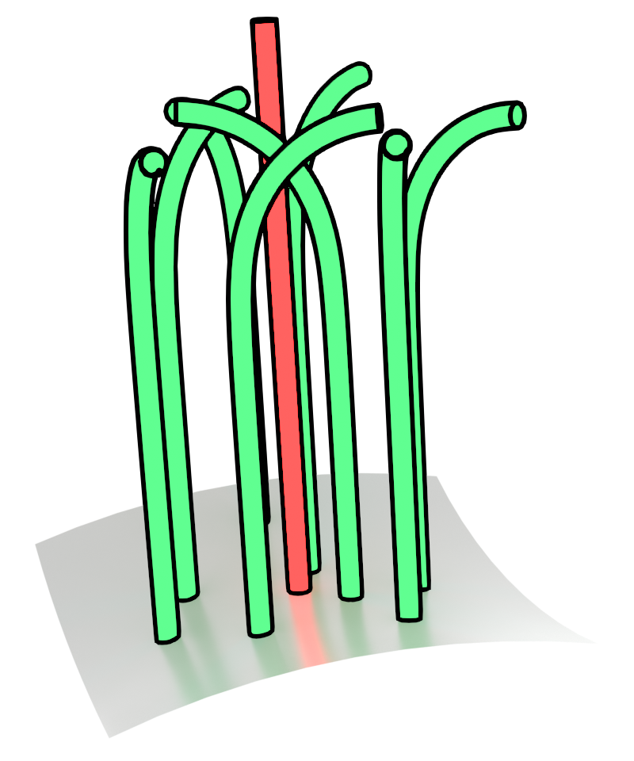
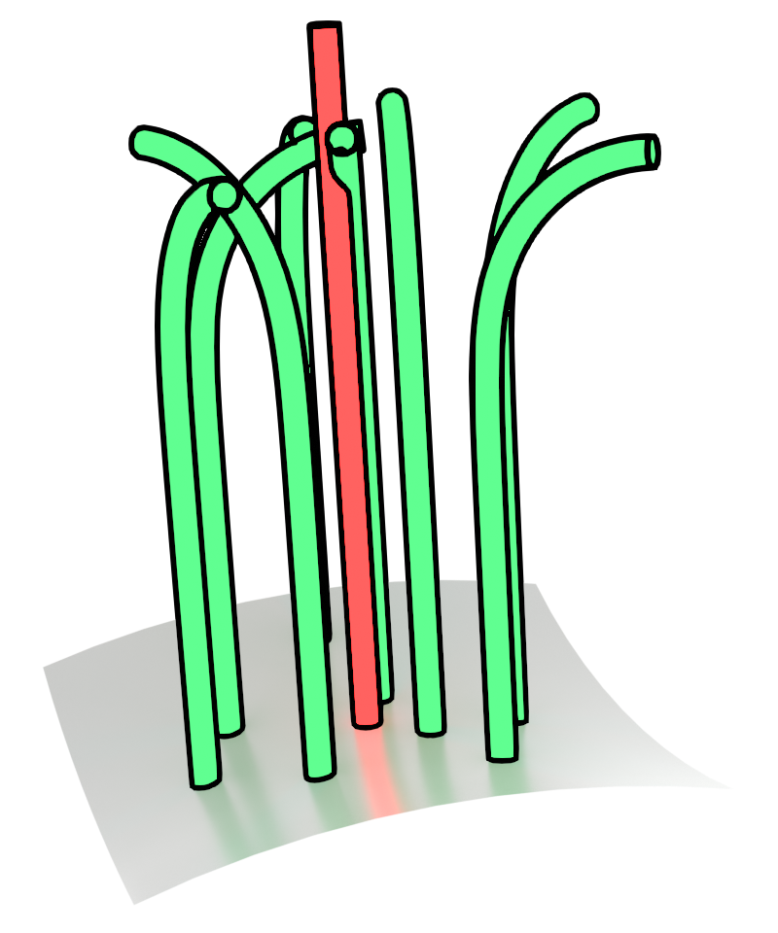
Key Idea: Look At Many Strands Together
≈
Notes:
So what should we do? Note that since we’re aiming for procedural hair, it unnecessary to reproduce exact individual strands, we really just need to reproduce the look of the hair, by matching the average hair shape and style across many strands.
And looking at an average of many strands together rather than matching individual strands is key!
In fact, we are going to show that we can infer good guides and operator parameters by comparing many strands together.

Slide 15
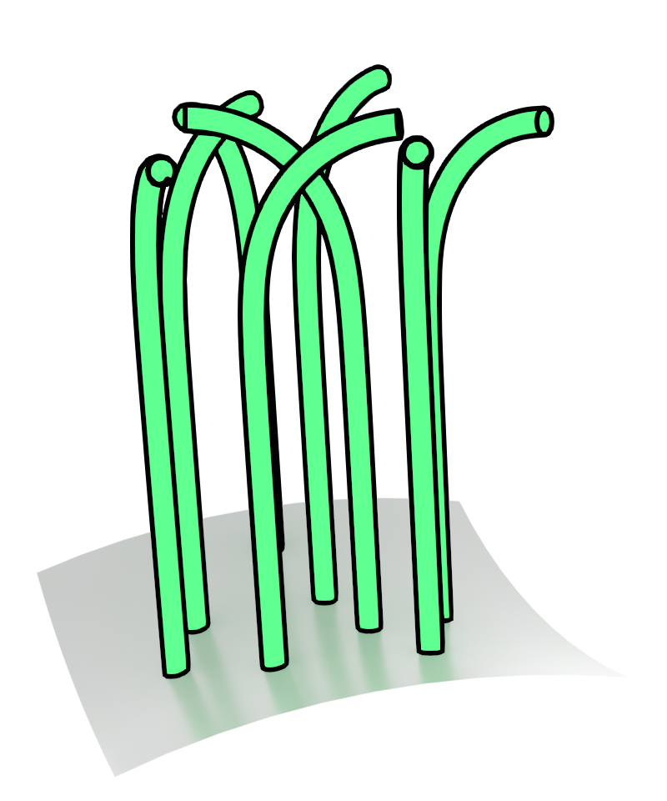
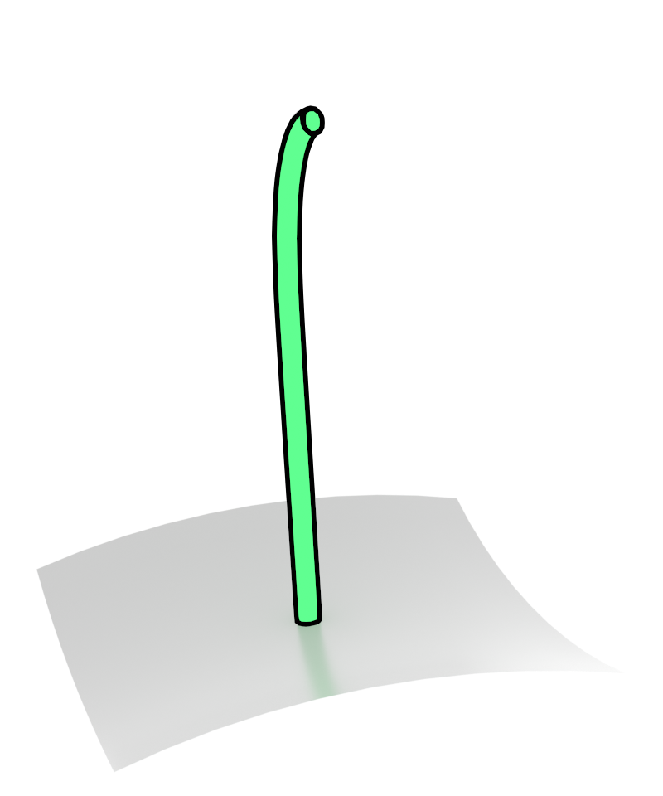
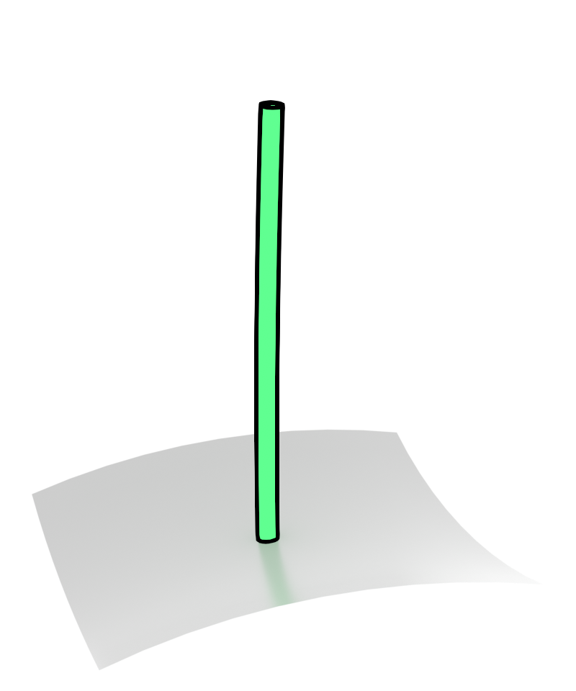
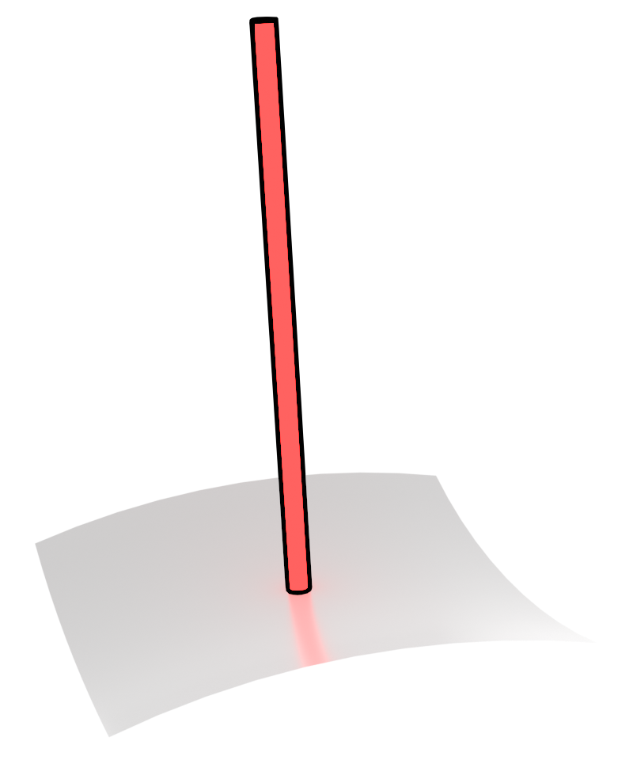
Guide Strands: Our Initialization
Assume guides are smooth
Average
≈
Smooth
Notes:
First, to optimize our guide strands, we assume that guide strands are typically smooth, and high frequency variation is added through operators.
And since variation is added randomly, then it’s often the case that the average of a bundle of strands gives a decent approximation of the guide strand.
We can therefore get a good initialization by clustering the strands and taking the cluster centroids.
These centroid strands can still have some effects of the operators so we further smooth along the strands form the guide strand.

Slide 16
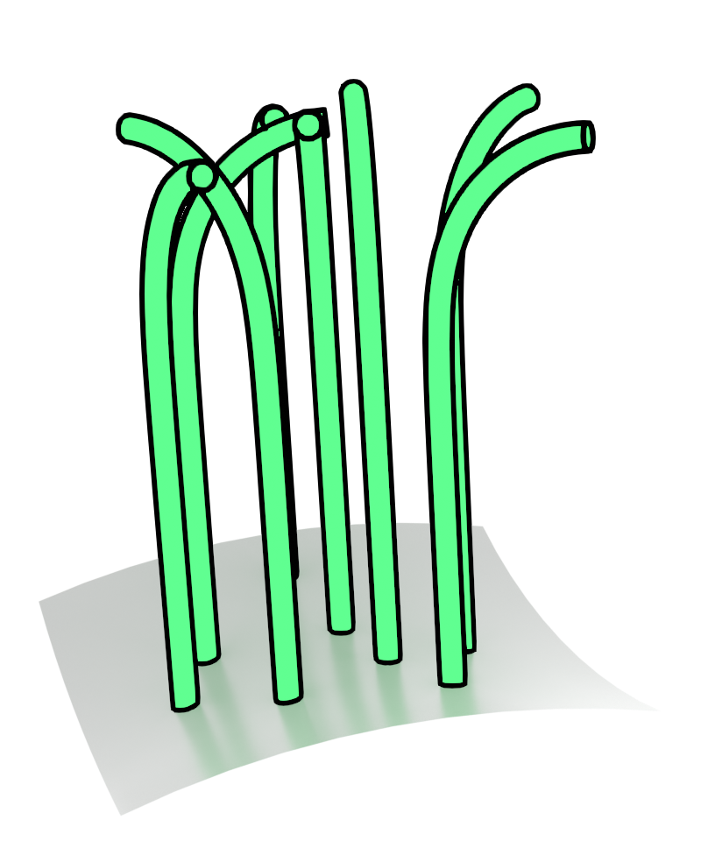
Guide Strands: Our Refinement
2
Loss
≈
Average
Average
With smoothness using
Smoothing through curvature reparameterization
[Crane et al. 2013]
Edge-aware gradient filtering
[Chang, Yang, Belhe et al. 2024]
Notes:
We then further refine the guide strands by running gradient based optimization using a loss function that sort of compares the averages of the strands. We show in our paper that this boils down to a simple L2 loss on vertex positions with a preference for smoothness using previous work on robust curve evolution and mesh gradient filtering.

Slide 17
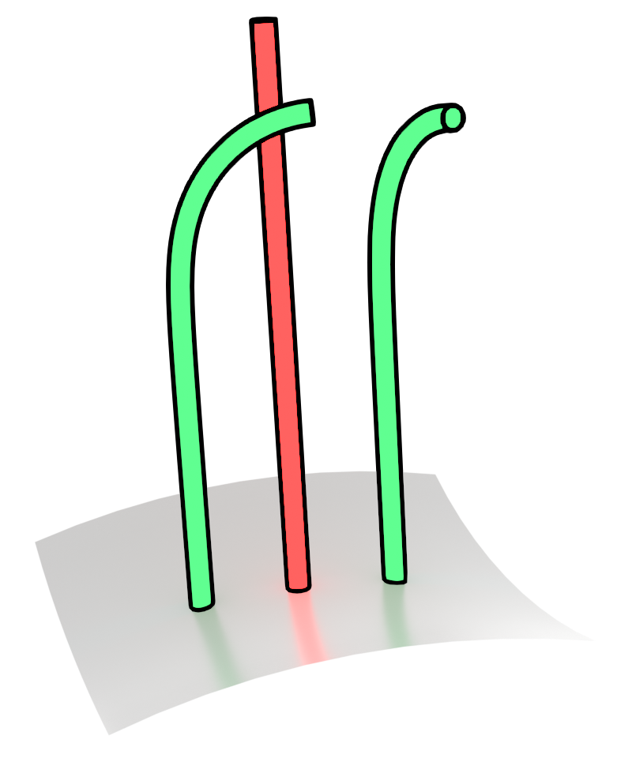
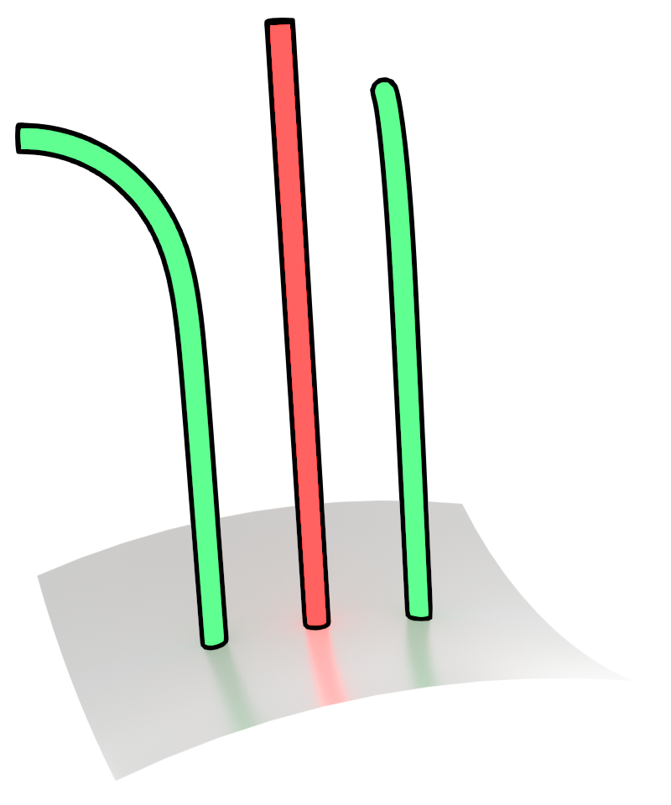
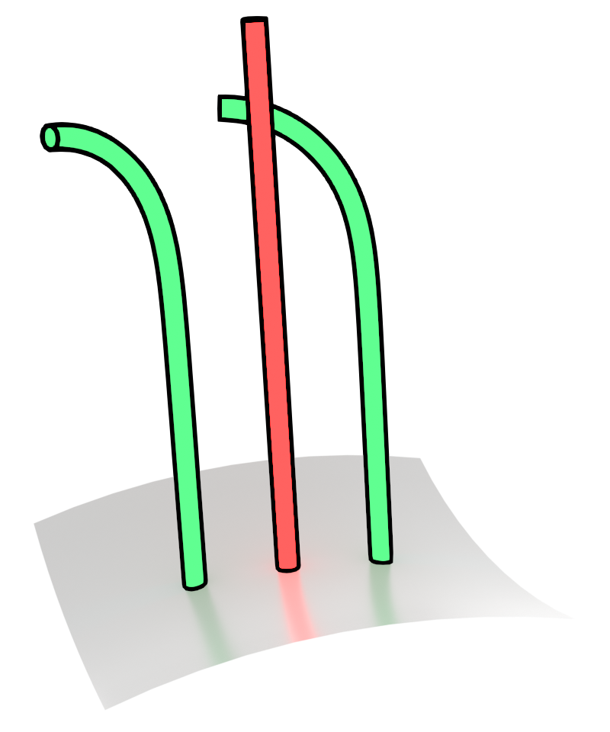
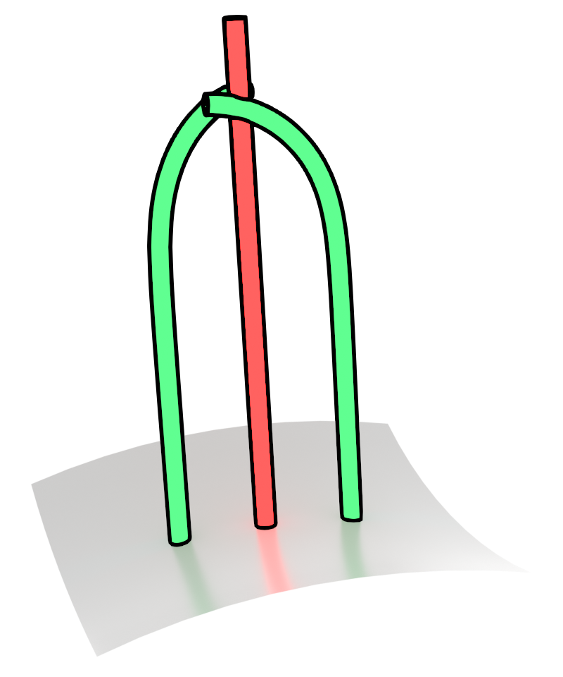
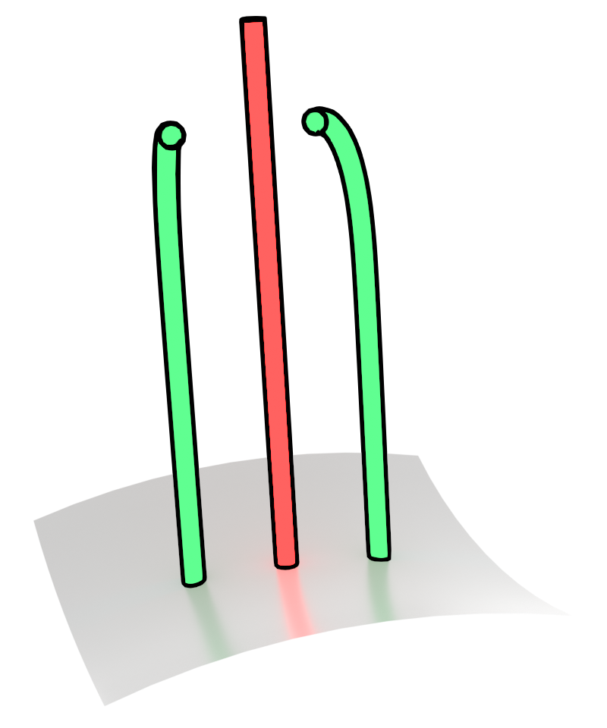
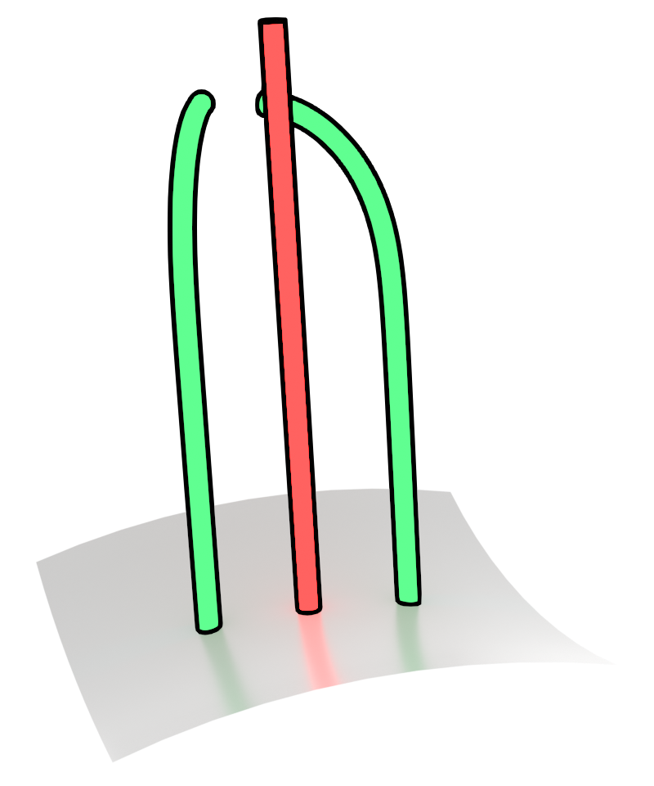
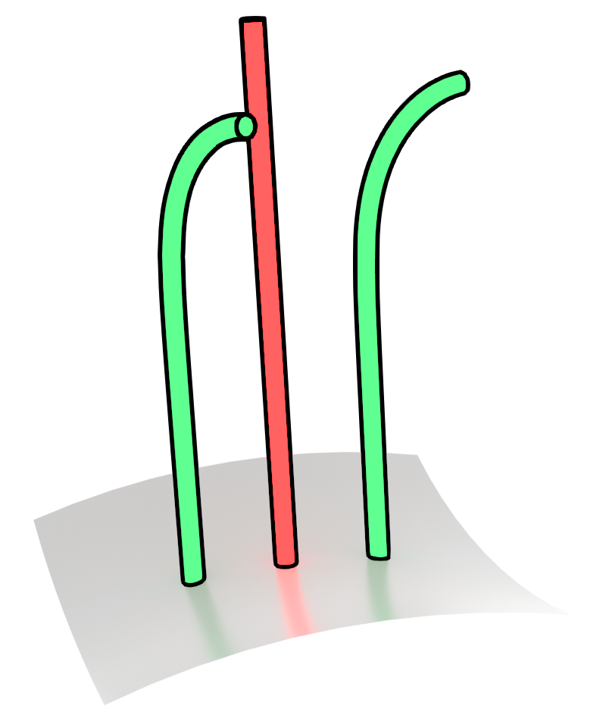
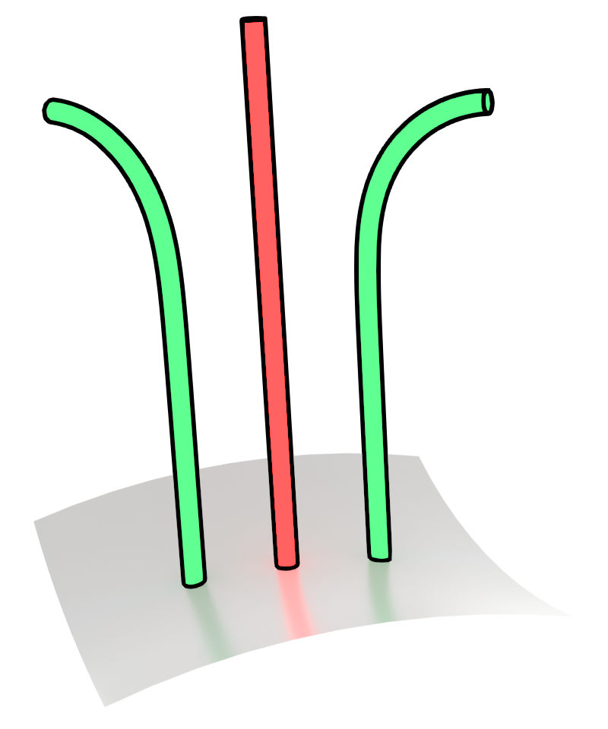
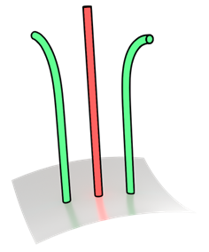
Operators: Strand Distributions
Distribution
can
generate any of
Sample
Notes:
Next, to optimize our operators, we take advantage of random variations. This bend operator bend strands around random axes, and so it can really generate
any of these strands. We just decided to pick one of them.
Another way of looking at this is that operators can generate a distribution of grooms, and each groom is a single sample from this distribution.

Slide 18
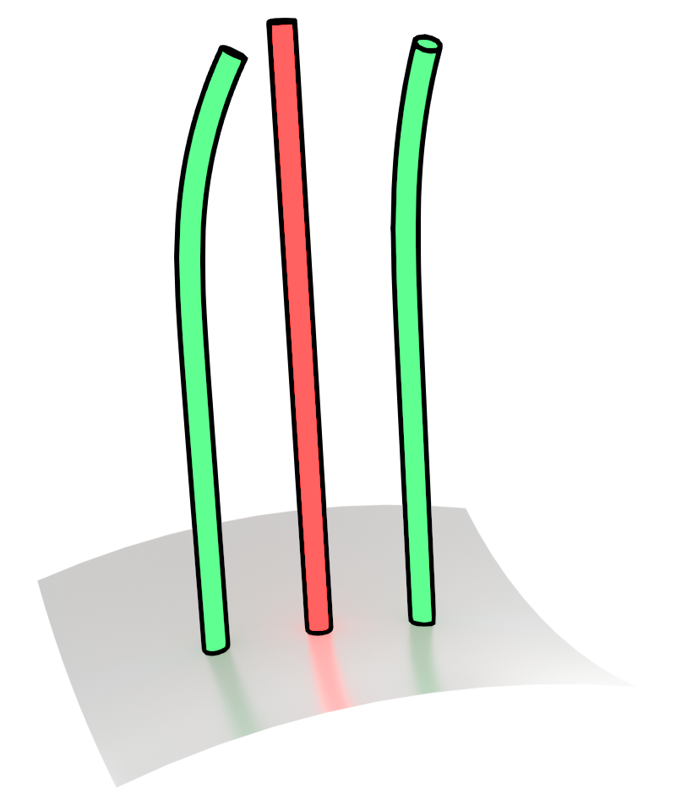
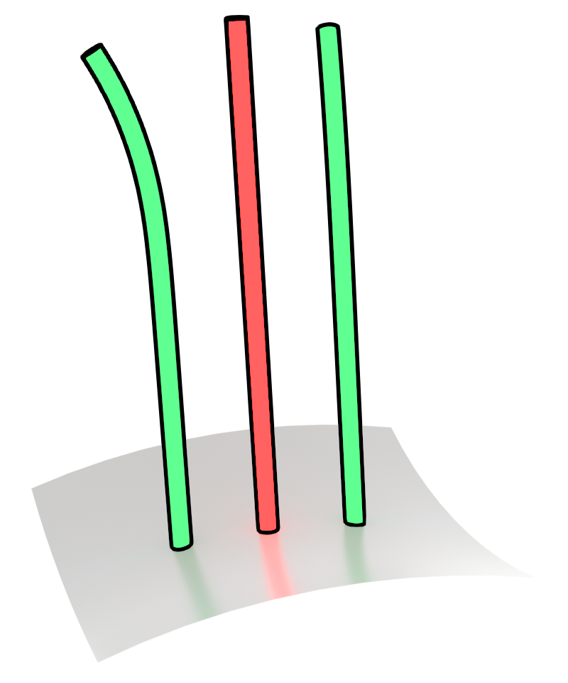
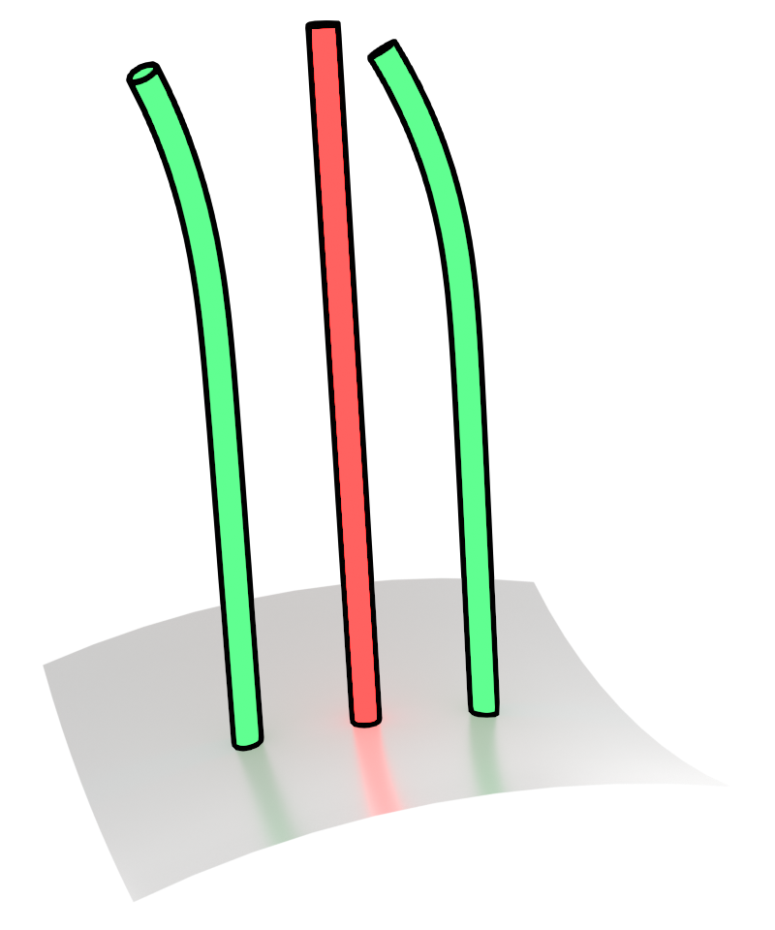
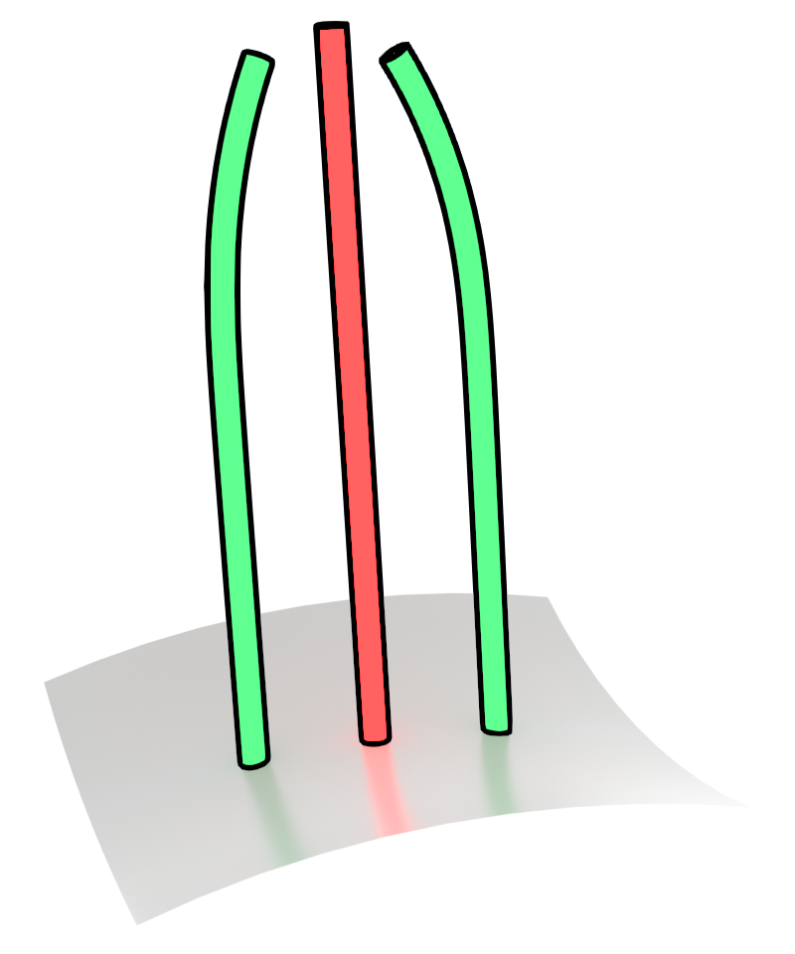
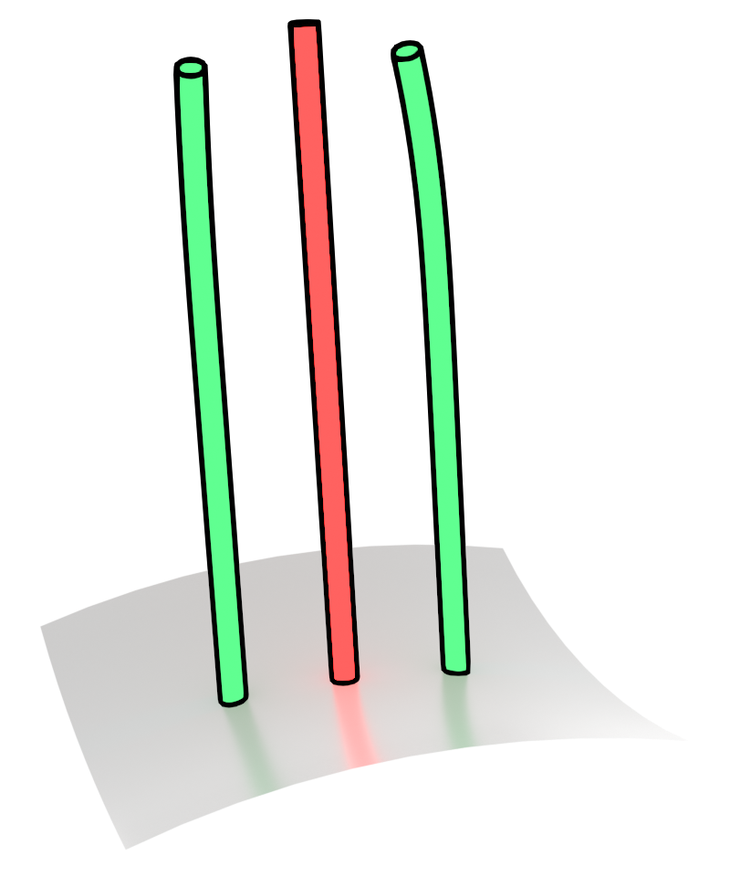
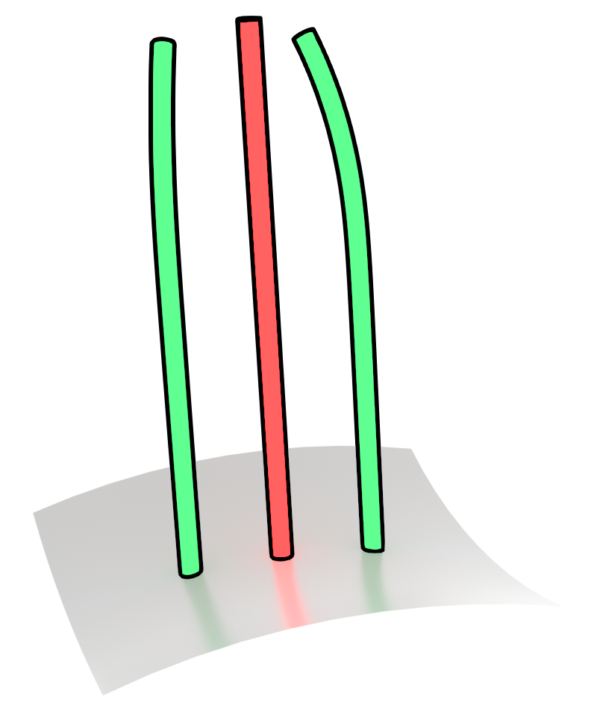

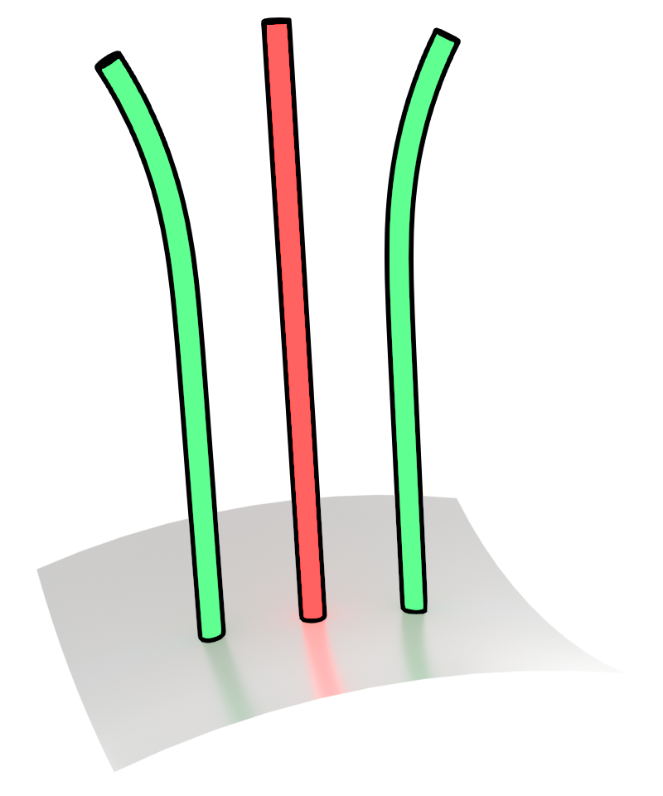
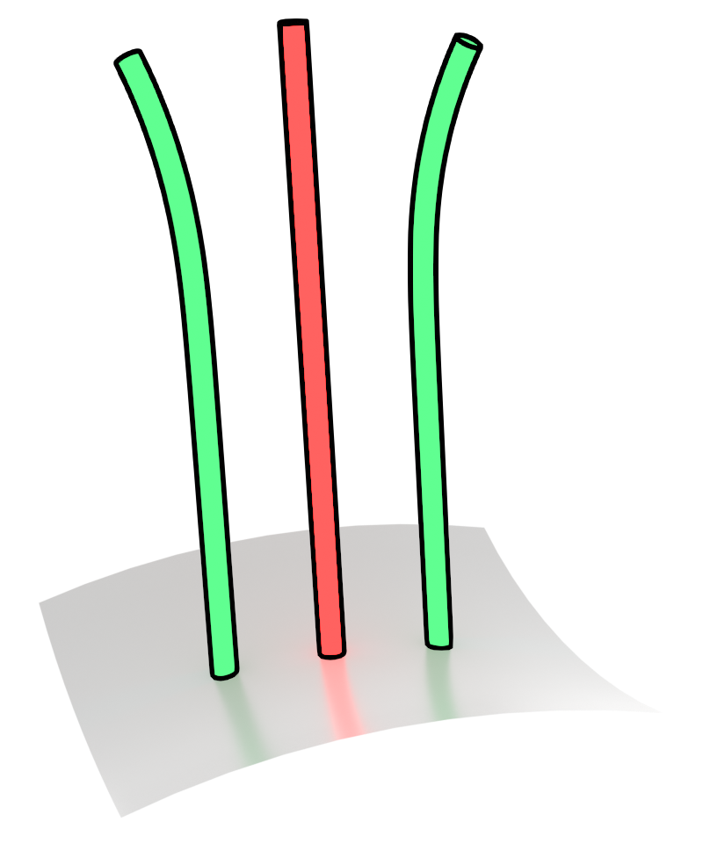
Operators: Distance Between Strand Distributions
2
Notes:
Now you can imagine that if we had all samples from these distributions, then we could design a distance that can distinguish between bend angles.
A distance between distributions removes the challenges of the random variation.
This however, is not practical since it would require multiple versions of the grooms. But we really don’t need this, since grooms have many thousands of strands.

Slide 19

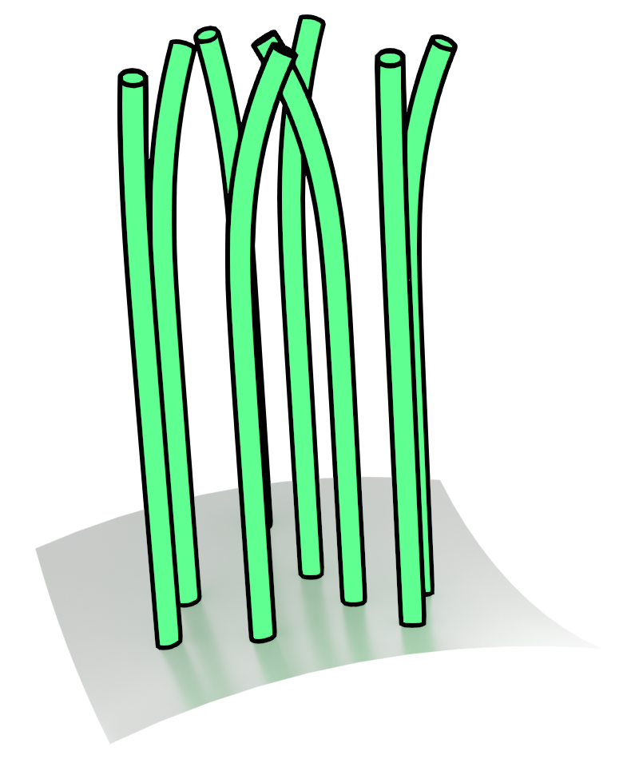
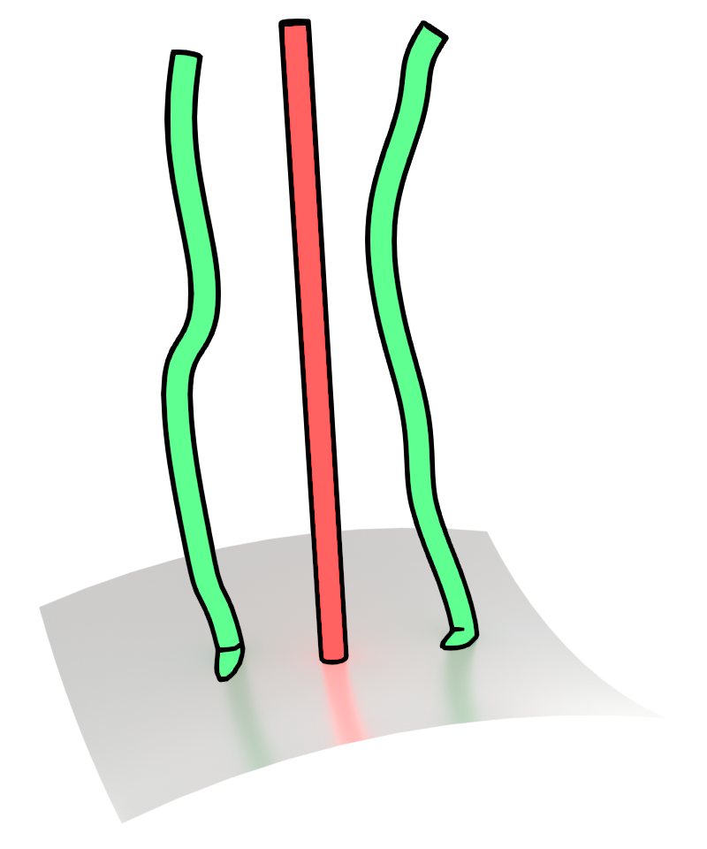
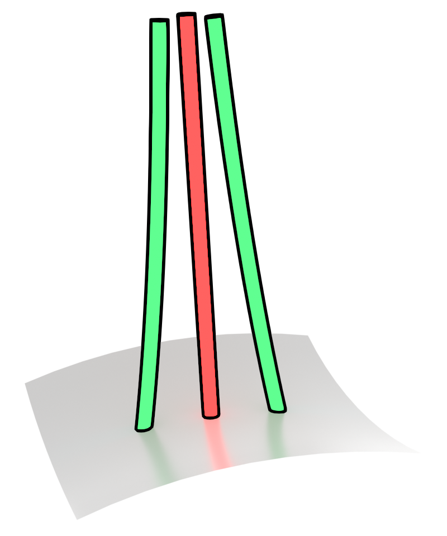
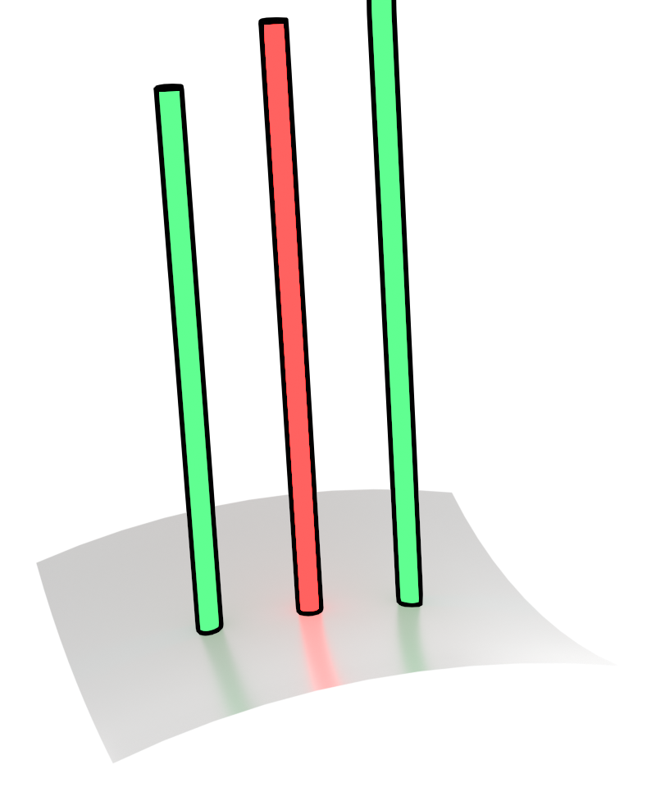
Operators: Our Loss Functions
2
Distribution
Distribution
Shape Operators
Correlation Operators
Sliced Wasserstein Loss
Determinantal Point Process Loss
Notes:
If we just treat each strand as a sample, then looking at many strands together gives us these samples.
And so instead of using a loss function that compares points on strands, we use loss functions that match distributions of strands.
In our paper, we show that some operators affect mainly the shape of the strands, while others affect the correlation of the strands, or the pattern of how neighboring strands differ from each other.
The particular distribution loss functions we use are a sliced wasserstein-based loss for the former, and a determinantal point process loss for the latter, which you can learn more about in our paper.
This gives us what we need to optimize guides and operators!

Slide 20



Results: Our Loss Gives Accurate Parameters
Target Groom
Our Groom
Naïve Loss
Notes:
Now let’s look at some results. When we optimize for synthetic hairstyles using our loss functions results in good optimization convergence, while the naïve point-based distance leads to incorrect parameters, such as the lack of curls here.

Slide 21



Results: Our Loss Gives Accurate Guides
Target Guides
Our Guides
Naïve Loss
Notes:
Or baked curls in the guide strands here.

Slide 22

Editing
Notes:
Using our procedural model, we can easily edit this coily hairstyle. We can increase hair length, add bend variations to the coils, change the frequency of the coils, remove them, add and remove noise, and remove clumps.

Slide 23

Transforming Real Hair
< 15 min to optimize on RTX 4090
Notes:
We transform reconstruction results from state-of-the-art hair reconstruction methods and show that our grooms look similar. This takes no more than 15 min on a single RTX 4090 GPU.

Slide 24

Editing Real Hair
Notes:
And we enable easy edits which would otherwise requires hours of artist expertise.

Slide 25

Simulation
Notes:
Finally, since our grooms have good internal structure, we can easily use them in simulation.

Slide 26


Thanks!
Procedural grooms enable editing of real hair
Open questions on selecting operators,
Extending to production grooming pipelines
Wesley Chang
Email: wec022@ucsd.edu
Project Page: weschang.com/publications/iphg/
Code: github.com/facebookresearch/iphg
Notes:
We’ve taken the first step, but there is still a lot of exciting work to be done! Figuring out the what operators should be used in a particular groom would enable a true automatic system. Extending this to support complex graphs of operators like as seen in Blender and Houdini would also enable expressing more challenging hairstyles seen in the real world.
You can find our code here, and feel free to contact me with any questions! Thank you!

